Slide 1
Restaurant Simulation Game
A tool for teaching business concepts
April 2024
Draft !!!

Slide 2
Business students always say…
“I want to start a business”
“I know everything I need to know”
“This is going to be easy. I love what I do.”
“I know I’ll make money doing something I love”
“This is a piece of cake, I saw XYZ do it on the internet”
“I don’t need to understand…”
Startup deal financing
Workforce scheduling and planning
Menu creation and Pricing

Slide 3
What’s needed is a realistic, teaching tool that mirrors a real life restaurant startup
Realistic
Lots of planning and work each month
Low profit margins
Variying levels of difficulty
Traing mode – Wins every time
Easy mode – Create full menu. Raise prices but not too much. Cut staff but not too much.
Medium mode. More responsibility.
Hard -- only 5% chance of lasting five years
Comprehensive
Menu planning and pricing
Inventory management

Slide 4
Simulation uses standard Restaurant Model
30%+ 30% + 30% + 10% Model
30% Cost of goods sold
30% labor
30% indirect and owners salary
10% profit
Demand Model is based on Local Population
Price model uses competition
Wage model use competition and laziness factor

Slide 5
Goals
Goals
Teach high school level adults about restaurant business
Learning programming. Publish program – to aspiring coders
Student goals
Paper and Spreadsheet model first
Operate restaurant – nuts and bolts
Teach basic economic and business concepts
Read P&L and Balance Sheet
Cashflow
PED – Price Elasticity of Demand for products and wages
Wage issues
Inflation & Interest Rates
Win game

Slide 6
Features
Good restaurant model
30-30-30-10 Model
Financing and loans affect profits and owners equity
PED – Price affects sales
Wage PED – Wages affect worker productivity
Good Demand Model
Local population
Restaurant type
Competition
Full inventory model –
Stock out reduces sales
Manual purchasing is more efficient
Comprehensive P&L
Dashboard for ease of use
Limit effects
Pricing affects sales
Employee capacity affects sales
Inventory affects sales

Slide 7
Game play
Turn based game
Monthly results in P&L
Yearly Results

Slide 8
Business Types / Lines of Business
Restaurant
Restaurant with Liquor License (Future)
Food Truck
Retail Sales (Future)
E-Commerce (Future)
Future inventory business: Dollar Store
Service Business (Barber Shop, Hair Salon, Cleaning, Delivery, Catering) (Future)
Bakery

Slide 9
Exit / End / Winning conditions
About 50% bankruptcy rate - open
Positive cash flow after 5 years (50%)
Own the building that houses the restaurant
Sell business for 3x yearly revenue – 15% broker fee
Business is worth $1 million
Lose business in divorce, taxes, fire
30 years. Mayor gives key to city.
Leave business to kids

Slide 10
Gameplay Summary -- Monthly Game Cycle
Decide on Menu and Price. Guess quantities.
Purchase Supplies (Auto purchase available)
Schedule Labor
Advertise and Promote
Review Short Term Results
Good News
Labor shortage
Food Shortage
Seat Shortage
Bad news
Low demand
Make Changes

Slide 11
Restaurant Game Process for Teachers
Form Teams
Put together a financing plan. Where will you get the money. Figure out how much money you have. Get loan, ask family, work.
Basics: Choose Restaurant Type, Location, Theme, Menu, Brand
Conduct, Buy or Skip Marketing Research.
Develop business plan. Organize company. Get government paperwork and permits.
Renovate Store. Fit out (Decorate) store
Market business. Promotion.
Grand Opening
Operate store
Change Prices
Change menu
Promote store
Cut cost / raise prices
Lease / Buy equipment
Expand, Milk Business, Let business go down hill
Exit Plan: Sell Business, Close, Bankruptcy, Lose Assets

Slide 12
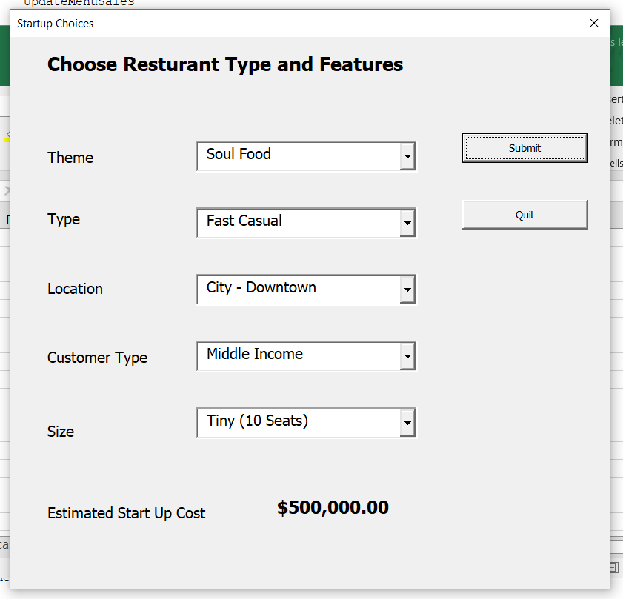
Restaurant Type and Location

Slide 13
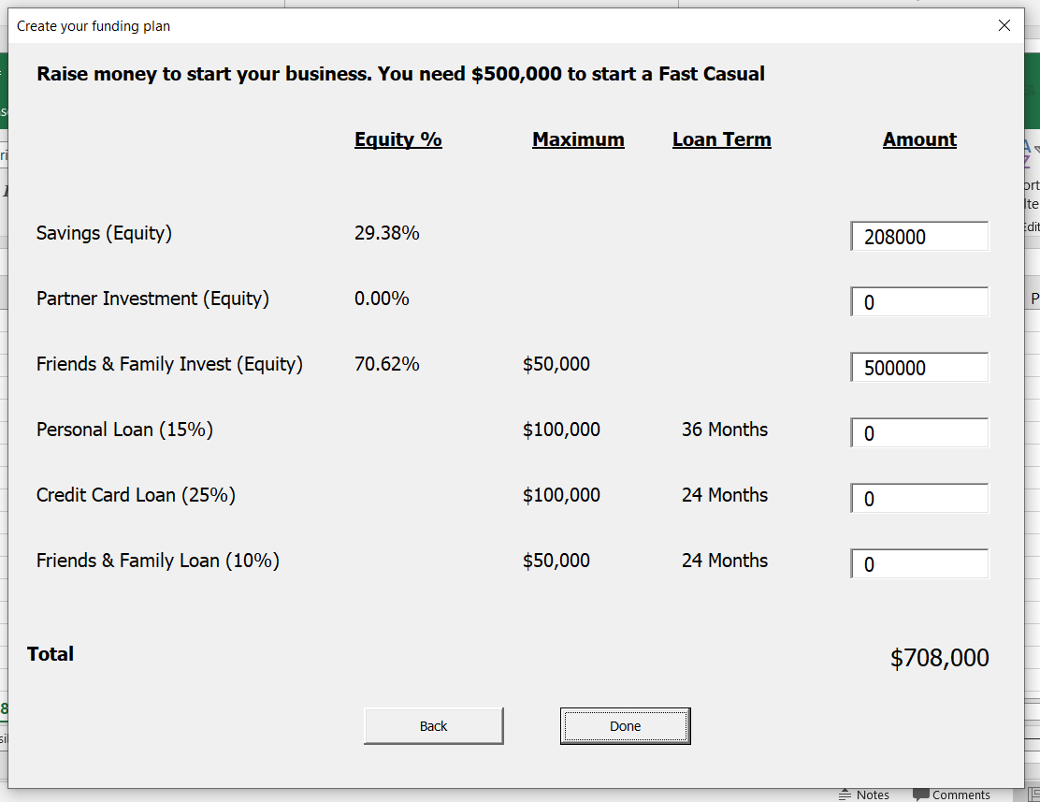
Financial Structure

Slide 14
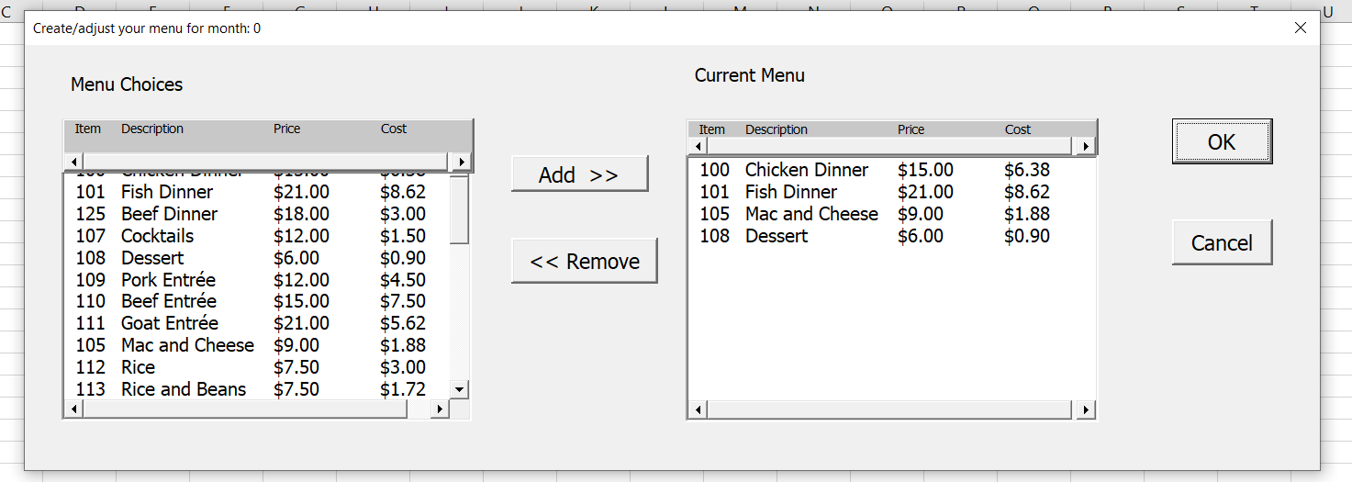
Menu Choices

Slide 15
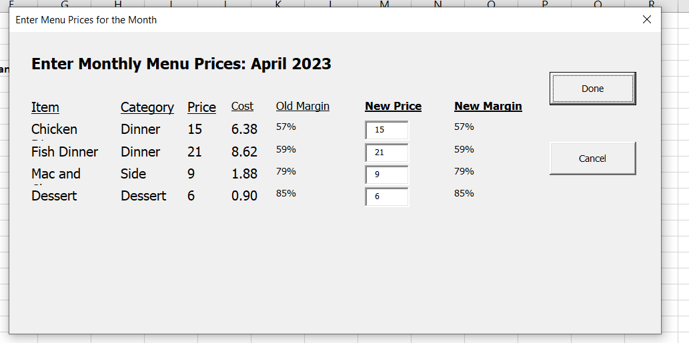
Menu Prices

Slide 16
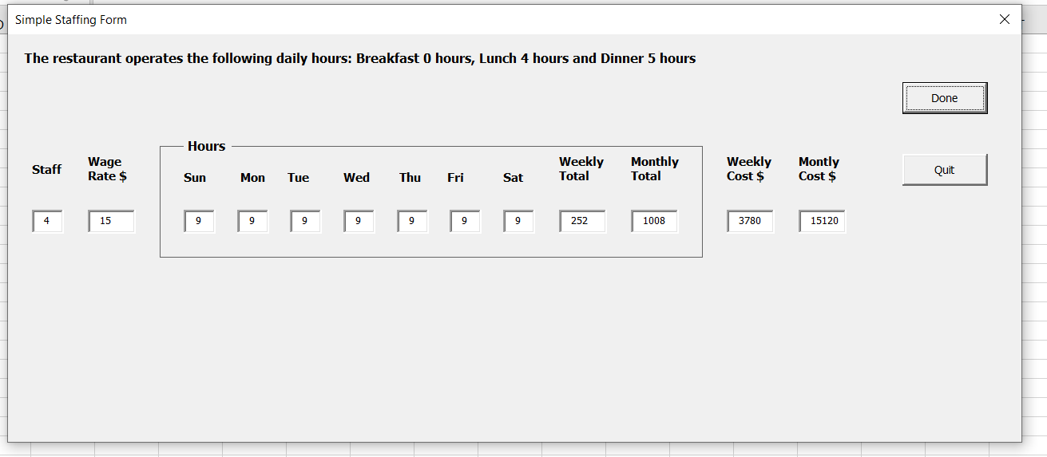
Employee Staffing

Slide 17
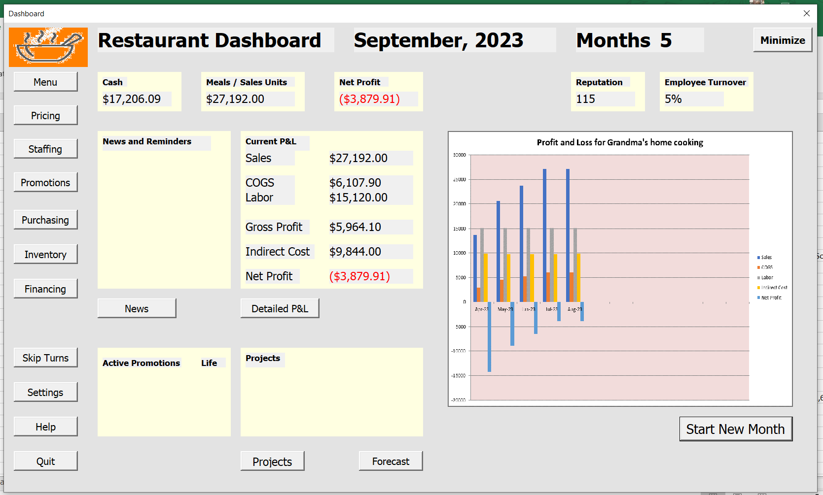
Operating Dashboard

Slide 18
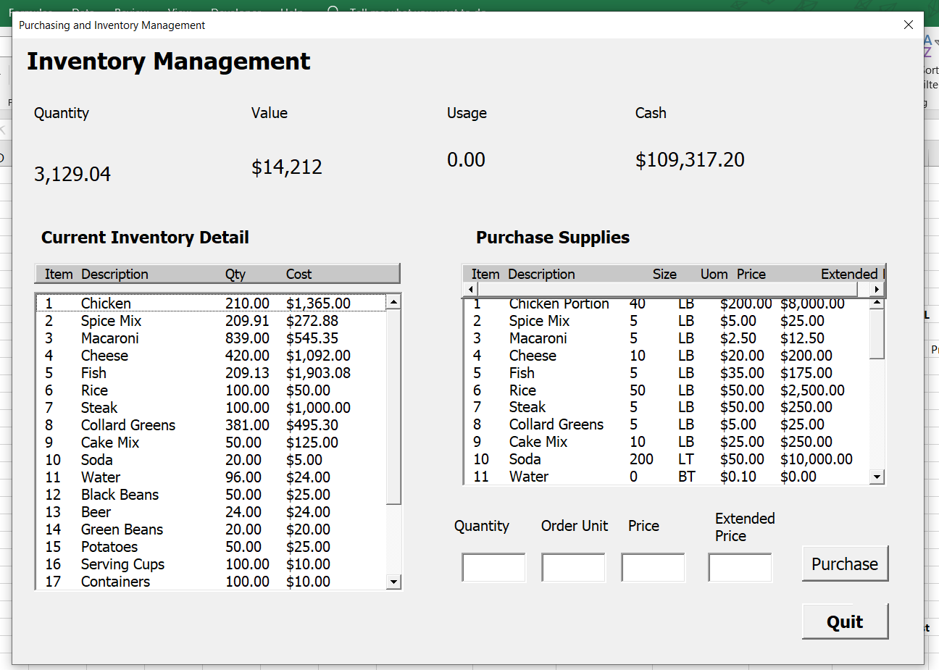
Purchasing and Inventory Management

Slide 19
Current Issues
Weak HR model
Bad graphics
Cannot win – good !!!
Projects
Blank space on dashboard
Owners health and happiness
Lack of fu

Slide 20
Restaurant Simulation Model
Game play model and business model
April 24th, 2024

Slide 21
Process flow
Make choices – set-up game
Financing
Restaurant type and location
Menu
Employees
Review P&L
Adjust Choices
Run until you run out of money

Slide 22
Key Variables
Demand Curve
Typical product adoption curve but with a stable tale
Random spikes and drops
Demand is Adjusted for restaurant type and location
Demand to Sales conversion rate
Average Wage Rate
Interest Rate
Economy Growth Rate
Price Elasticity of Demand
Employee Wage / Productivity Curve

Slide 23
Restaurant Simulation Game Model
Select Restaurant characteristics and location
Select Menu
Select Prices
Choose Staffing Level
Start Game
Review P&L Chart
Review P&L and Balance Sheet
Adjust Game Parameters
Start Next Month
Review Yearly P&L

Slide 24
Restaurant Simulation Business Model(Easy)
Select Restaurant characteristics and location
Calculate raw demand
Adjust demand for restaurant characteristics
Calculate Sales
Adjust sales for prices and worker capacity
Calculate COGS
Write P&L and Balance Sheet
Auto purchase inventory
Start Next Month
Review Yearly P&L

Slide 25
Restaurant Simulation Business Model (Medium)
Detailed financial plan. Work is an option.
More competition
More detailed staffing model
Employee quits and employee productivity
In-game financing. Cash out.
Owner time use and happiness
Investor dividends
Manual purchase inventory (auto is 20% higher)
More uncertain demand

Slide 26
Restaurant Simulation Business Model (Medium)
Less startup money
More competition
More detailed staffing model
Front office workers vs. back of house
More uncertain demand

Slide 27
Proposed Enhancements
October 2022

Slide 28
Top Enhancements
Stable version – Done
Stable Beta Version – in process
Menu price / cost – Done, finally fixed costs
Screen Flash – Open, Technical
Forecast demand units ?? Is forecast correct ? -- Open
Install on different computer
Yearly indirect costs – insurance – Done
Credit card bills - Done
Dashboard after set-up -- Done
Liquor License – 1st project
Reputation Feeds sales -- Done
100> increase sales
<100 decrease sales
Wage rate feeds productivity – Check
Missing features: Projects, Liquor License, Save game and employee model

Slide 29
Enhancements
More stability
Validate more scenarios
Table restaurant
Food truck
Ghost kitchen
Inventory Model
Sit down restaurant with liquor license
Improve HR model --Owner and employees
Employee productivity needs to be adjusted – 20% idle time breaks cell phone
Employee turnover does not work well
Family Restaurant with unpaid employees
Handle Tipped employees
Employee taxes and benefits
Is forecast needed – adjust forecast for coming year
Better yearly totals and grade
Fix owners equity
End game total

Slide 30
Top Enhancements - 2024
Dashboard after set-up - Done
Liquor License
Front of House and Back of House – Staffing (Expert)
Reputation Feeds sales - done
100> increase sales
<100 decrease sales
Wage rate feeds productivity

Slide 31
Technical questions
How to get the program on the internet ?
Javascipt
Architecture
Should the program be in Python
Should it be in VB.net
Should it be an app
Javascipt on internet
What database should it use ?
Should it take a different approach with classes
What about the UI / UX ?

Slide 32
Look and Feel
Simpler and more consistent
Reduced input screens and fields (for example finance screen)
Stop screen flash
Hide non-essential spreadsheets
Select Restaurant brand, look, colors, logo and theme
Determine menu size / maximum menu size

Slide 33
Liquor License
$200,000
Markup 4x
Every diner has one drink with the meal. 20% have two drinks.

Slide 34
Cost management - Done
Inventory
Purchasing
Suppliers or Restaurant Depot
Ingredients cost and quality
Restaurant Depot
Provision Delivery
Equipment
Depreciation

Slide 35
Labor management
Owner
Sweat Equity – Number of partner less required labor
Family workers get paid what owner can afford
Owner opportunity cost to work elsewhere. For projects.
Owner and family hours subtract from total labor cost and requirements
Wages
Assignments
Scheduling - Nope

Slide 36
Sweat Equity / Finance
Partner Hours Contributed
Unpaid Overhead
Management 40 Hours Monthly
Purchasing & Inventory 10 Hours Monthly
Payroll 10 Hours Monthly
Taxes 5 Hours Monthly
Total Unpaid Overheard Hours 60 Hours
Projects

Slide 37
Owner / Employee Happiness
Status / Social Standing
Meet People
Health / Mental Health / Drug Use
Family
Work-life balance
Mental

Slide 38
Projects and Capital Decision
Buy building
Buy equipment
Renew lease
Lease vs. Own
3-month, 6-month and 12 month project list (new drink menu)
Project cost money and time. Owners time. They cannot be delegated
Bank loan. Secured loan.

Slide 39
HR model -- open
add HR model
add complex HR staffing
Job roles
Pay grades
Staffing
Front of house / Back of the house

Slide 40
Finance
Detailed financial planning Switch
Inventory Management Switch
Purchase Liquor License
Salary, equity or both
Personal taxes
Payments
Credit Cards - Done
Gift cards
Refinance

Slide 41
Timing / Constraints
You can only change three / five menu item in a month. If inventory management is active you must pre-order the ingredients

Slide 42
Unclassified
Bottled water soda and use drinks - done
' *** open add HR screen - make HR impact sales and cost
add catering
*** Change menu every 3 months – medium mode
' *** Major menu change is a project for 6 months or a year. Doing the project unlocks menu options
'long term
Economic Environment
add recession and expansion
Purchasing and Inventory - done
add inventory screen
add order screen
Inventory carrying costs. Inventory expiration.
' Food quality – ha, ha, ha, but upscale menu items
Purchase market research screen –Start-up

Slide 43
Team play or against the computer
This is insane !!!
Maybe on-line

Slide 44
Other / Miscellaneous
Employee turnover rate
Employee experience
Reputation feed sales
You turned away 600 customers
Sales price 1 to 3 times sales
75% to full capacity
Labor
Management 8-10%, Hourly 18-20%, Benefits 5%, Payroll Taxes 4%
Rents 8%, net income taxes 5%
Golden Hour 2x – 3x
6-9pm or 12-2pm
Average monthly revenue is $112, 000.
Restaurant unchanged should generate 5% profit

Slide 45
Tipping and Tipped Wage
Bartenders
Waiters and Waitresses

Slide 46
Taxes
Income Taxes on Business Profits
Federal
State
FICA and Payroll Taxes
Workman's compensation
FMLA
Tipped Wages

